Slide 1
Unit 2-Informed Search Strategies

Slide 2


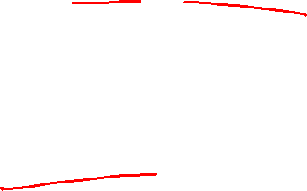
Informed Search Strategies
Uninformed search strategies are good; However, they are not guided well towards the goal.
They keep on looking everywhere for the solution.
Informed search encourages moving towards the goal.
Some intuition (can be correct or incorrect), guess or heuristic is added to the problem.
In Heuristic search, selection of the path to go towards the goal must be done smartly.
Which path to try and which not to try
Informed search algorithms uses the problem definition and some problem specific knowledge for the search.
What knowledge is given other than the definition?
Arad to Bucharest : How far is Bucharest? Which city is closest to Bucharest and which is the farthest? Path length(guess done on the distance)

Slide 3
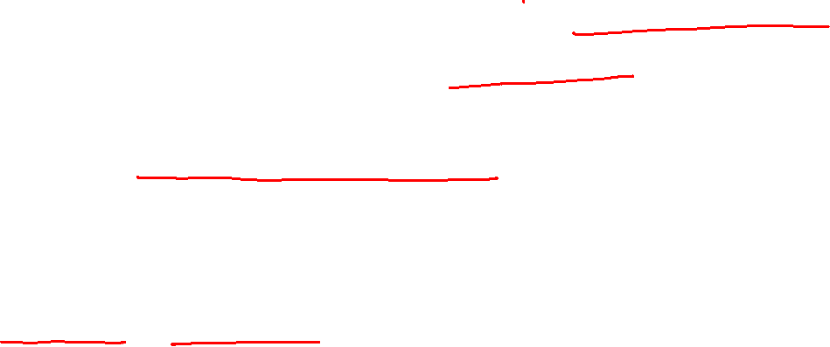
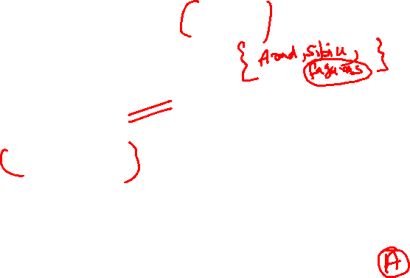
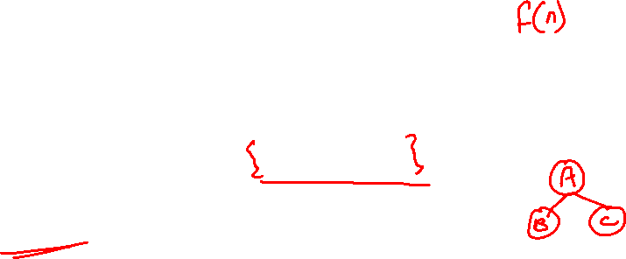
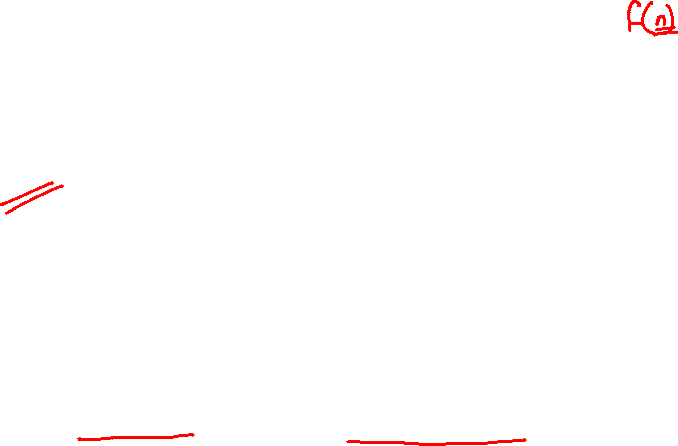
A node is selected for expansion based on an Evaluation function.
Evaluation function estimates the cost of the goal.
How does it work?
From the fringe or frontier or open list choose the best node x based on the evaluation function f.
If the node x is the goal stop or else expand it using the SUCCESSOR_FN(X)
Closed list or explored list contains the nodes which are already explored. This is to avoid repeating the exploration of a particular node.
If the node x is not the goal node, add it to the explored list so that while expanding we can do the duplicate checking.
If node is in the explored list, it will not be considered for expanding and will be added to the fringe.
When a node is removed from the fringe, we have found a goal.

Slide 4
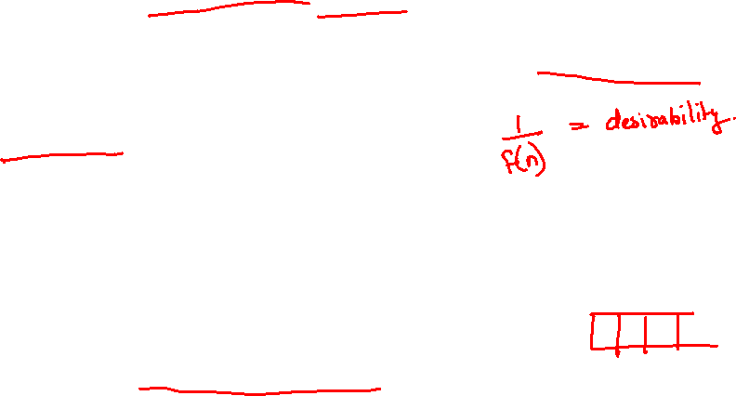
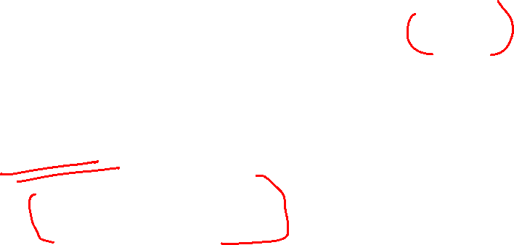

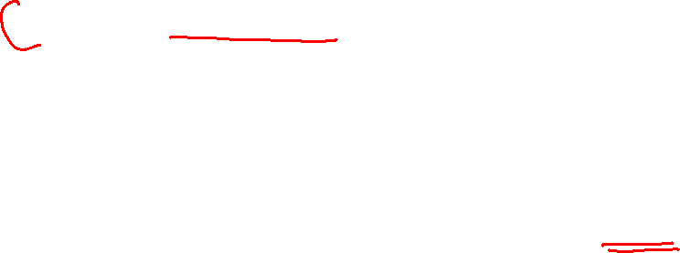
Best First Search
Uses an evaluation function f(n) for node n
Always choose the node from the fringe that has the lowest f value
Idea: use the evaluation function f(n) for each node
Estimate the desirability, inverse of f(n)
Low f(n) is the highest desirable node
Expand the most desirable unexpanded node
Order the nodes in the fringe in decreasing order of desirability
Implemented using priority queue
Special cases of best first: Greedy best first and A*

Slide 5
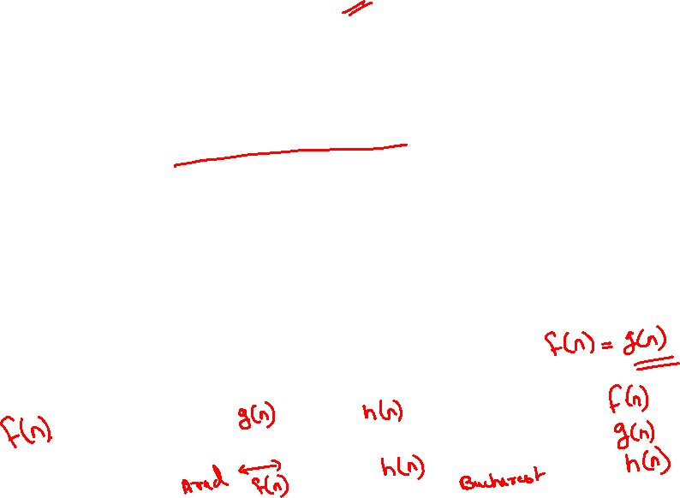
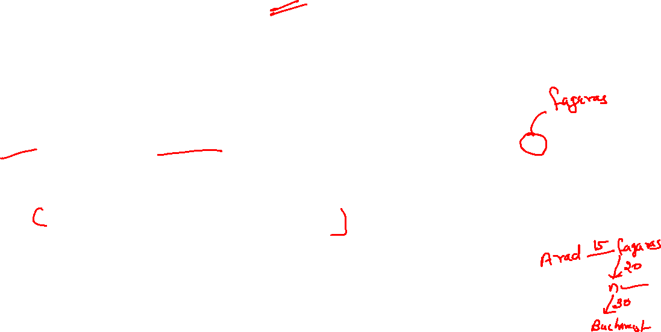
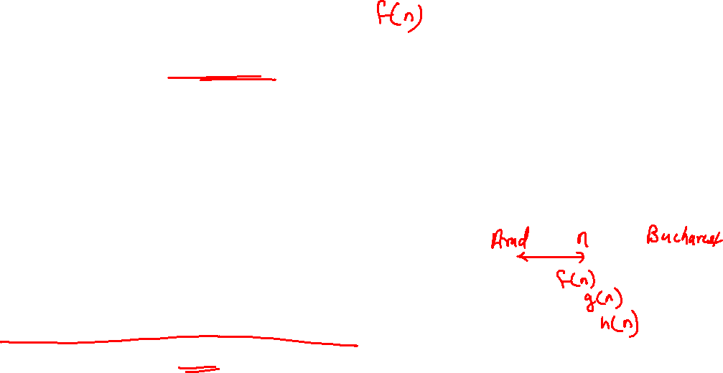
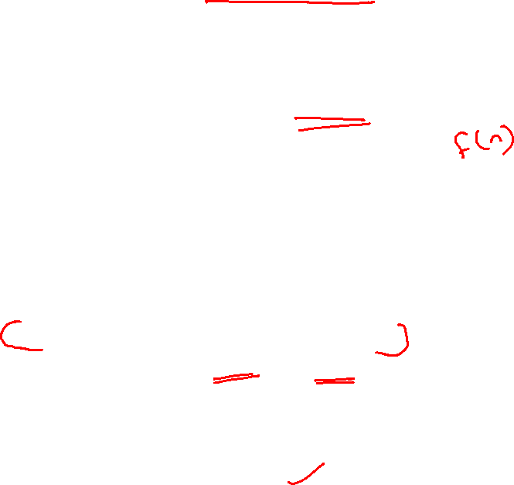
Breadth first Search vs Best first search
Breadth first search is like best first search
Evaluation function f(n) is the depth
I have several nodes in my fringe some are at higher levels and some are at lower levels, I pick the nodes at the lower depth.
Uniform cost search vs Best first search
Evaluation function f(n) is the lowest cost
Many nodes, and we expand the node at the lowest cost
Start state → n→ Goal state
n is the node which has the lowest cost from start to n
Find that node which has the lowest cost from start to n
f(n)=sum of edge costs from start node to n
This is measured as say g(n); f(n)=g(n)
g(n)= sum of edge costs from start node to n
start
n
Goal

Slide 6
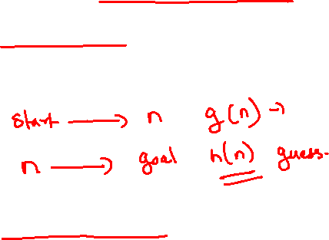
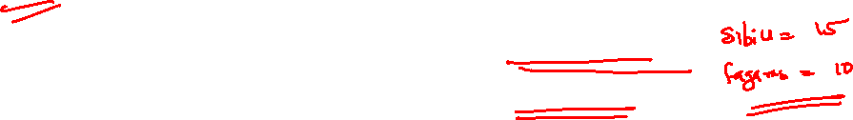
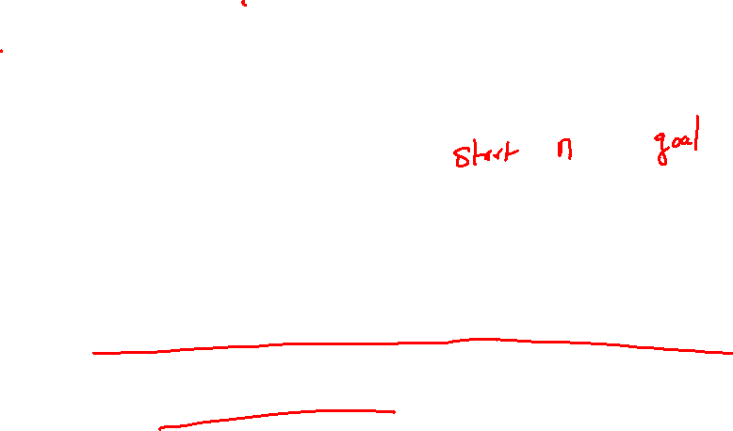

We have three functions now
f(n): evaluation function which decides which node to expand
g(n):sum of edge costs from start to n(closer node from the start)
h(n):estimate or heuristic guess of the cost from n to the closest goal(how far is the goal from me)
Greedy Best first search
Uses the h(n) function as the evaluation function
f(n)= estimate of the cost from node n to goal; f(n) = h(n)
e.g. h _{SLD} (n) = straight line distance from n to Bucharest
Greedy best first search expands the node that appears to be closest to the goal
Intuition or heuristic: I want to go to a node which appears to be closer to the goal

Slide 7


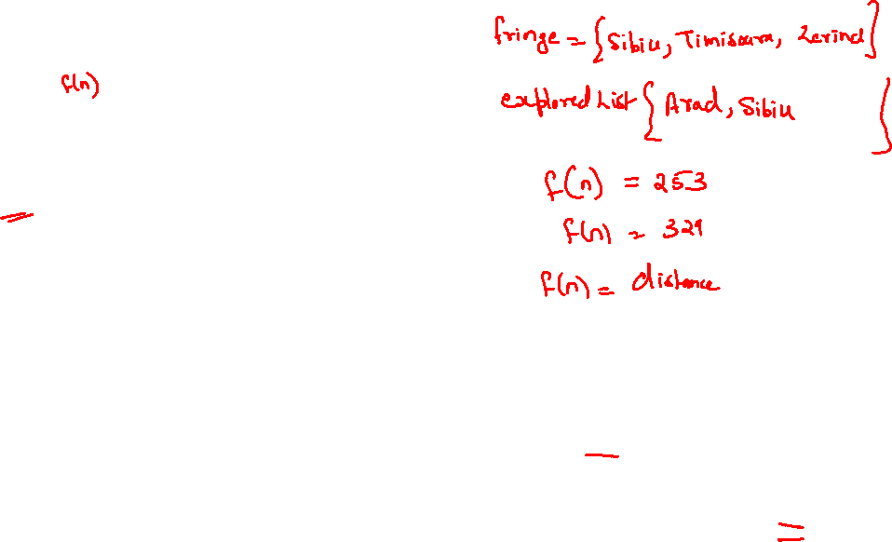
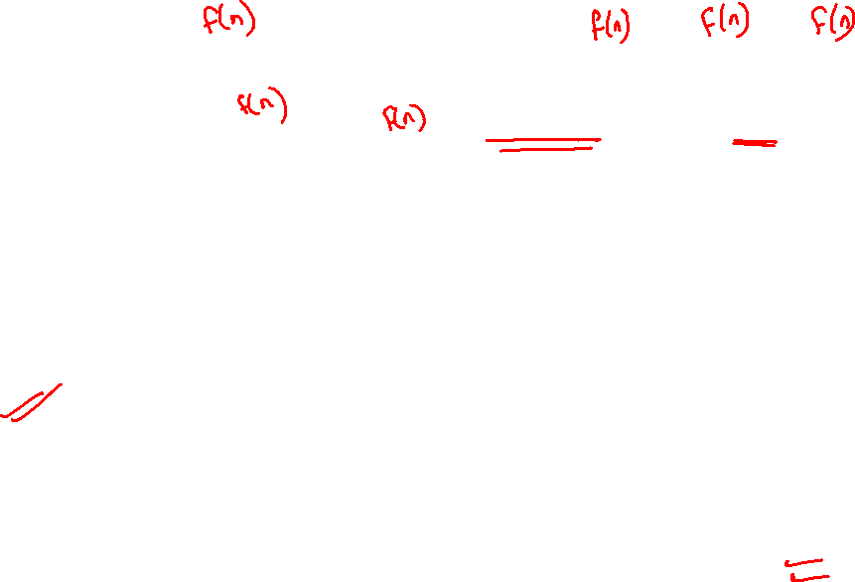

Slide 8

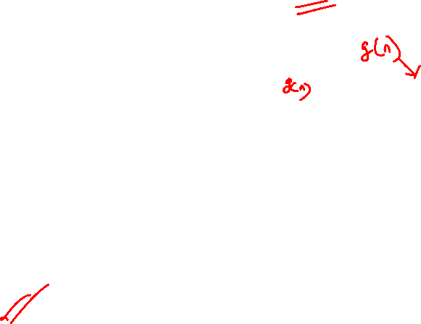


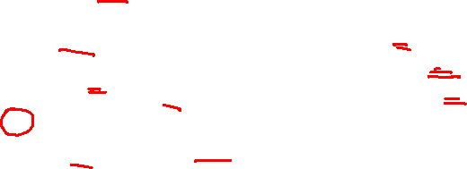
Evaluation: Is it a good algorithm?
Complete?
Suppose I have to go from
Iasi to Oradea
From Iasi I can go to Neamt and
Vaslui
h(n) for Neamt is 87 and for
Vaslui is 92
So I go to Neamt
From Neamt I can go to Iasi , from Iasi again two places Neamt and Vaslui
Neamt is better so to Neamt again. According to optimal h(n) I keep on looping between Isai and Neamt.
Can get stuck in loops so not complete

Slide 10

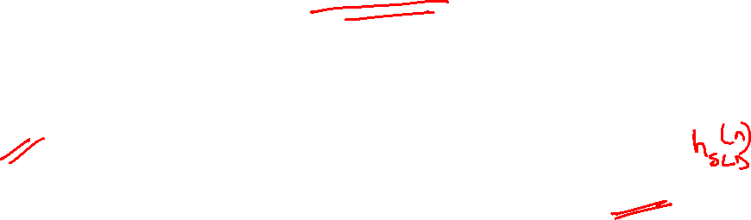
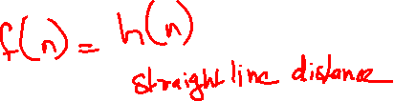

Time complexity?
Heuristic function can be either optimal or confusing, it can take to you to a path opposite to the goal
Worst case when (f(n)=h(n)) and h(n) is not optimal we end up exploring all the nodes to find the goal
O(b^{m})
If we have an optimum h(n) things can improve
Space complexity?
Fringe can become very large and can have all the nodes, so all nodes must be stored in the memory
O(b^{m})
Optimal solution?
Not complete so not optimal also

Slide 11

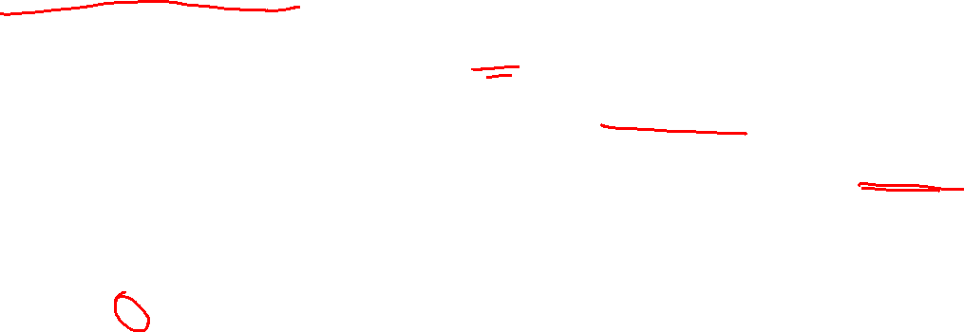

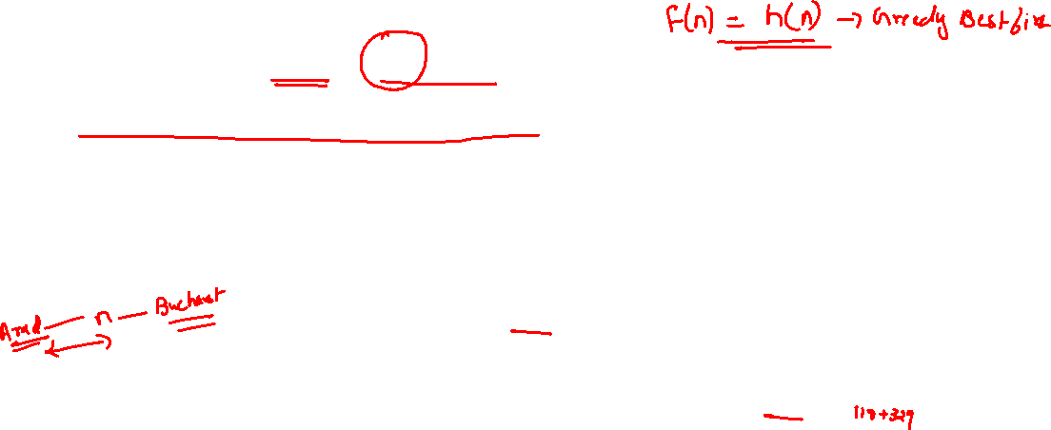
A* search algorithm
Idea: avoid expanding paths that are already expensive even though they are closer to the goal.
Evaluation function is f(n)= g(n)+h(n)
g(n) =path cost from start node to node n (cost so far)
h(n)= estimated cost of the cheapest path from n to the goal (future cost)
f(n)= estimated cost of the cheapest solution from start node to goal node through node n

Slide 12


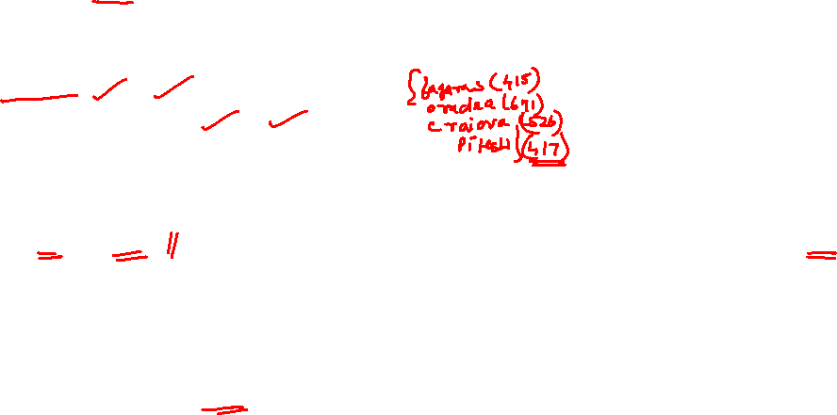
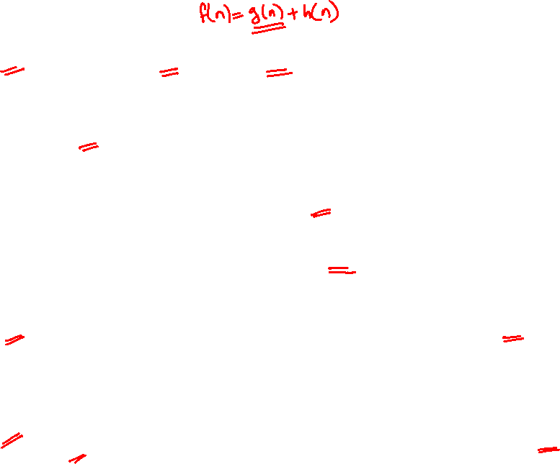
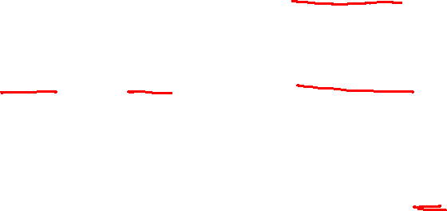
Arad:
f(n)=g(n)+h(n)
g(n)= 0
h(n)= 366 (straight line distance to Bucharest)
f(n)=0+366=366
Sibiu:
f(n)=g(n)+h(n)
g(n)= 140
h(n)= 253 (straight line distance to to Bucharest from Sibiu)
f(n)=140+253=393
Rimnicu Vilcea:
f(n)=g(n)+h(n)
g(n)= 140+80=220
h(n)= 193(straight line distance to to Bucharest from Rimnicu Vilcea)
f(n)=220+193=413
Fagaras:
f(n)=g(n)+h(n)
g(n)= 140+99=239
h(n)= 176(straight line distance to to Bucharest from Fagaras)
f(n)=239+176=415

Slide 13

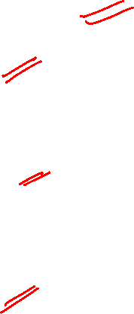


Nodes in the fringe now are
{Sibiu (591), Bucharest (450),Craiova(526),Pitesti(417),Sibiu(553)}
Bucharest is the goal and we have a path from Fagaras to Bucharest.
However, there are nodes in the fringe which are less in cost viz. Pitesti
That means there is some other path to Bucharest which is at a lower cost through Pitesti
Bucharest: (through Fagaras)
f(n)=g(n)+h(n)
g(n)= 140+99+211=450
h(n)= 0(straight line distance to Bucharest from Bucharest)
f(n)=450+0=450
Pitesti:
f(n)=g(n)+h(n)
g(n)= 140+80+97=317
h(n)= 100(straight line distance to Bucharest from Pitesti)
f(n)=317+100=417
Bucharest: (through Pitesti)
f(n)=g(n)+h(n)
g(n)= 140+80+97+101=418
h(n)= 0(straight line distance to Bucharest from Bucharest)
f(n)=418+0=418

Slide 14
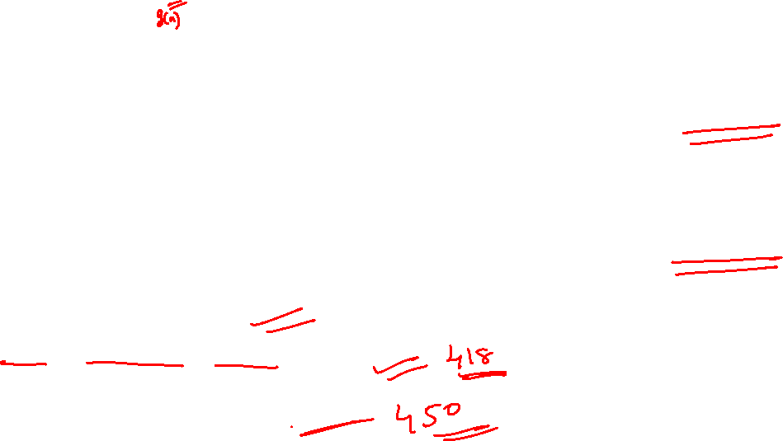
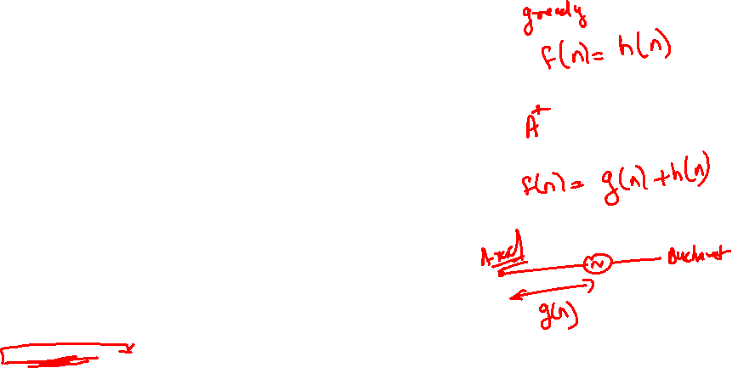
Optimum path returned is
Arad→Sibiu→ Rimnicu Vicea→ Pitesti→Bucharest
Alternative path is
Arad→Sibiu→ Fagaras→ Pitesti→Bucharest

